Slide 1
Wavecon Telecom Analysis

Slide 2
Content
Problem Statement
Analysis & Its insights
Conclusion
Thank you

Slide 3
Problem Statement
Wave con Technologies, a rapidly expanding mobile network provider operating in 15 cities across India, leveraged its exponential growth to adopt a new approach for launching 5G plans. They tasked analysts with providing insights based on thorough research to guide the implementation of these plans.

Slide 4
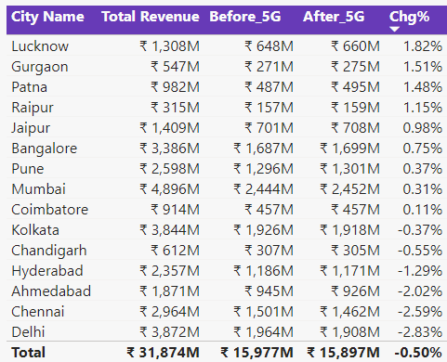
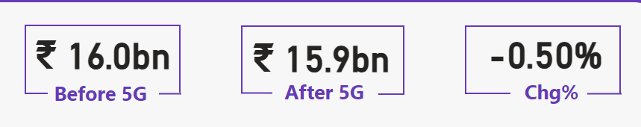
What is the impact of the 5G launch on our revenue?
The launch of 5G has resulted in a slight decline in overall revenue, approximately 0.50%. However, on a city-wise basis, Lucknow, Gurgaon, and Patna have emerged as the top three cities demonstrating positive growth following the 5G rollout.

Slide 5
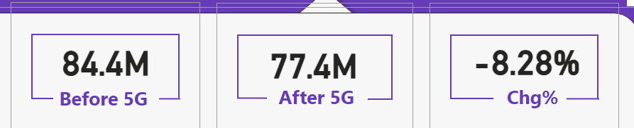
Which KPI is underperforming after the 5G launch?
The Total Active Users (TAU) experienced a growth decline of 8.28%, accompanied by a 0.50% decrease in revenue.

Slide 6
After the 5G launch, which plans are performing well in terms of revenue? Which plans are not performing well?
Following the launch of the new plans, including P11 (Ultra Fast Mega Pack - 3GB/day for 80 days), P12 (Ultra Duo Pack - 1.88GB/day for 55 days), and P13 (Mini Ultra Saver Pack - 750MB/day for 28 days), Plan P1 (Smart Recharge Pack - 2GB/day for 3 months) remains the only plan showing positive revenue growth. All other plans, however, are experiencing a decline in revenue, with overall performance across the remaining offerings showing a downward trend after the 5G launch.

Slide 7
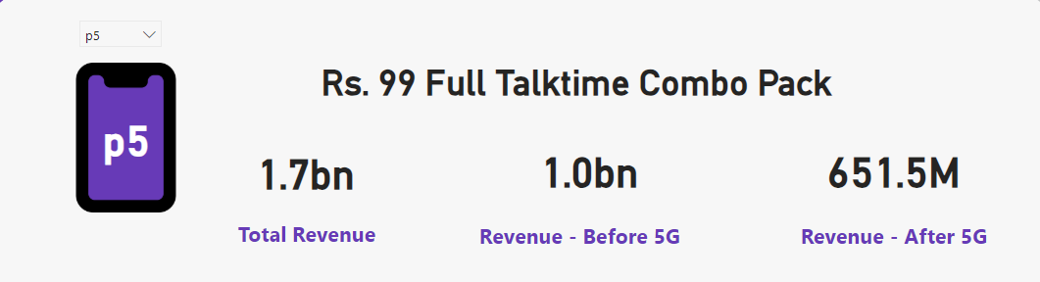
Is there any plan affected largely by the 5G launch? Should we continue or discontinue that plan?
The P5 (Rs 99 Full talk time Plan) has had a significant negative impact, with its revenue dropping from 1 billion to 651.5 million. Given the considerable decline, it may be advisable for Wave com Telecom to consider discontinuing this plan, as it is currently causing losses.

Slide 8
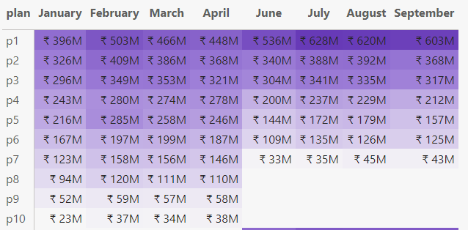
Is there any plan that is discontinued after the 5G launch? What is the reason for it?
Plans P8 (Daily Savior - 1GB/day, validity: 1 day), P9 (Combo Top-up - Rs 14.95 talk time and 300MB), and P10 (Big Combo Pack - 6GB/day, validity: 21 days) have been discontinued following the 5G launch due to the lack of consistent growth over the past three months.

Slide 9
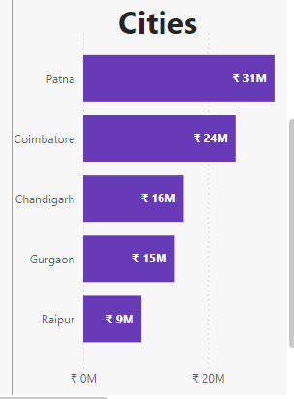
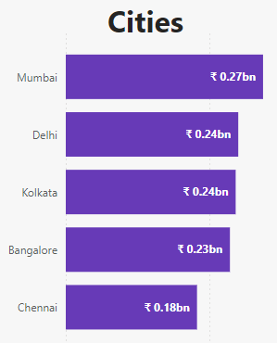
How are the top performers and bottom performers city wise after 5g launch in terms of revenue
INSIGHT: The top-performing cities in terms of revenue after the 5G launch are Patna, Coimbatore, and Chandigarh, while the bottom-performing cities are Mumbai, Delhi, and Kolkata.

Slide 10
CONCLUSION
Strategic focus is needed on optimizing high-performing plans and tailoring offerings for top cities like Patna, Coimbatore and Chandigarh.
Evaluate and phase out severely underperforming plans like P5 to mitigate losses.
Continue exploring growth opportunities in cities demonstrating strong revenue potential.

Slide 11
Thank you

